Slide 1
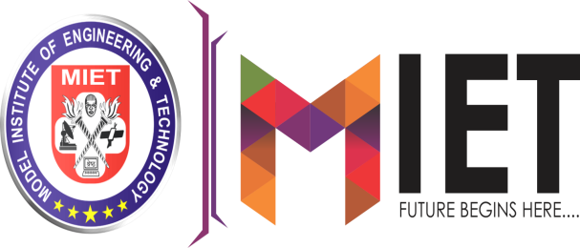

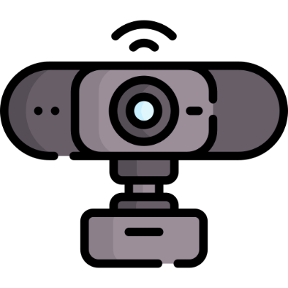
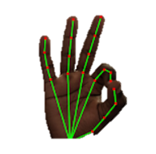
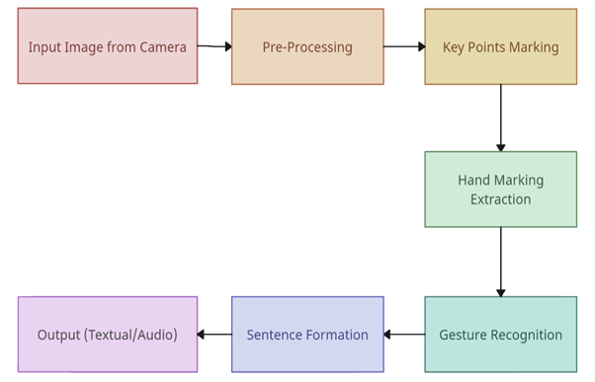
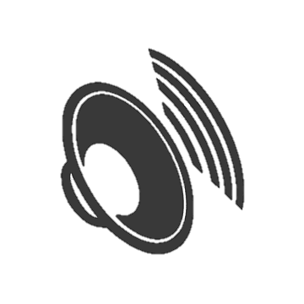
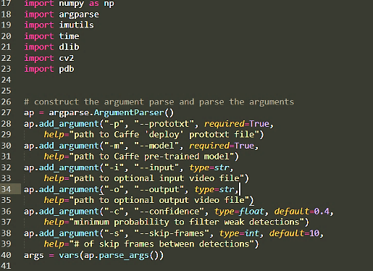
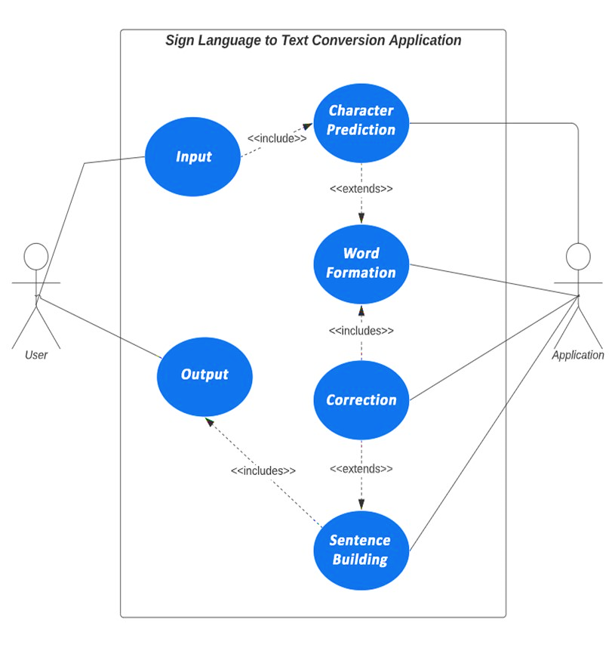
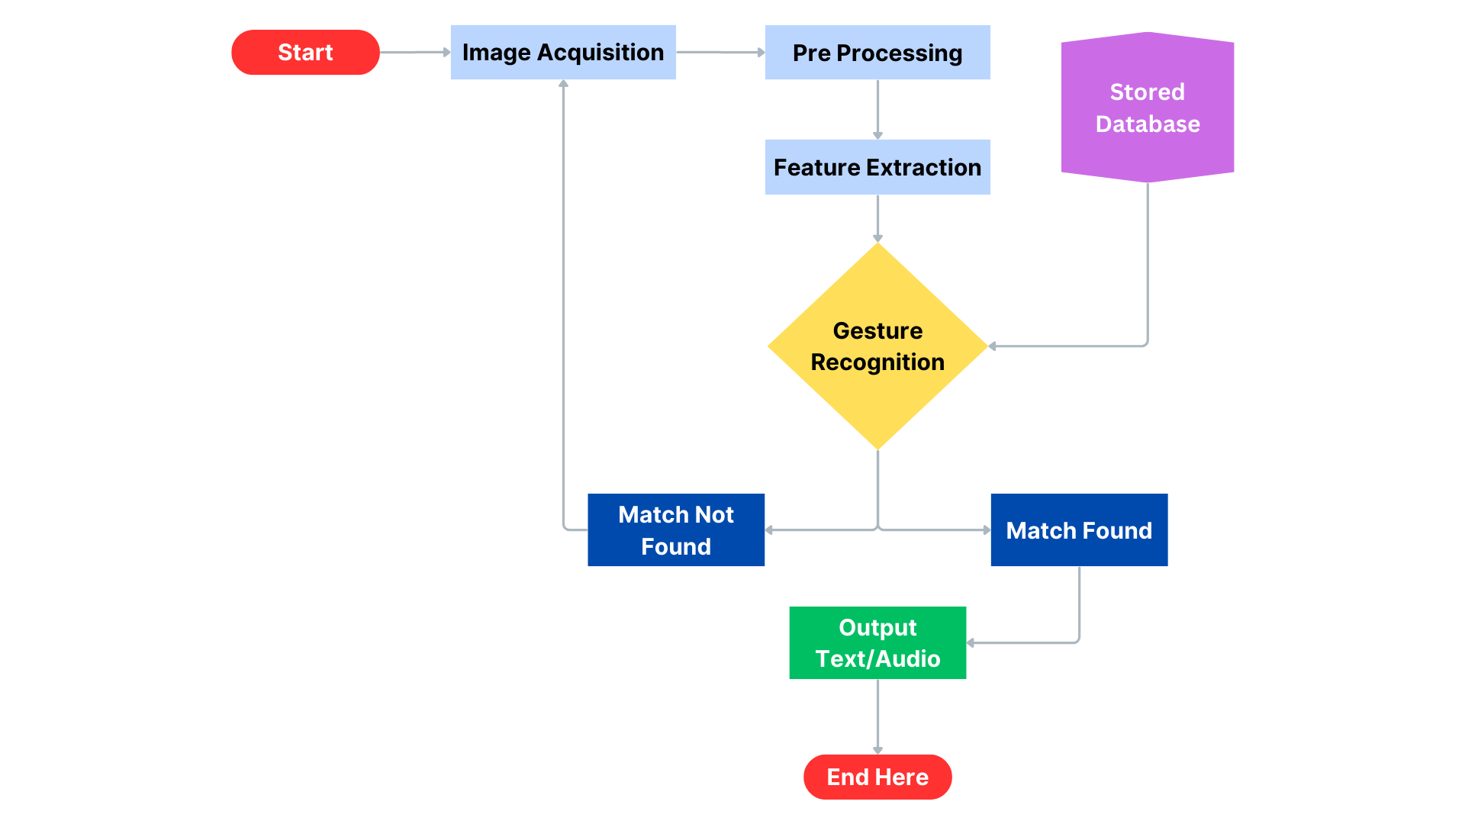

SIGN LANGUAGE CONVERSION
ANIKET SHARMA || DIVYANSH GUPTA
Abstract
Data Processing Workflow
The inability to speak is considered a true disability. People with this disability use different modes to communicate with others. There are several methods available for their communication, one of which is sign language. Developing a sign language application for deaf people can be very important, as it enables them to communicate easily with those who do not understand sign language. Our project aims to take the basic step in bridging the communication gap between hearing individuals and those who are deaf or mute, using sign language. The main focus of this work is to create a vision-based system to identify sign language gestures from video sequences. The reason for choosing a vision-based system is that it provides a simpler and more intuitive way of communication. In this report, 37 different gestures have been considered. This project involves an implementation using a Random Forest classifier with a Media pipe hand-tracking framework for Sign Language Conversion. After presenting the details of the training procedure setup, we proceed to evaluate the system on standard benchmark sets. We report an average accuracy of 99%, which demonstrates that the proposed model is efficient, precise, and robust. Real-time, accurate detection using the Random Forest classifier algorithm without any wearable sensors makes this technology more comfortable and easier to use. All our core demos and peak train architecture have been released under an open-source license in our public repository.
Innovation & Impact
INNOVATION:
Real-time detection and translation of sign language.
Comprehensive sentence generation for natural communication.
Recognized text is converted into speech for auditory feedback.
IMPACT:
Empowers deaf/mute including those who do not understand sign-language
Promotes inclusivity and accessibility in various domains such as education, employment, healthcare, and social settings.
Absence of wearable sensors and the reliance on common hardware.
Architecture Diagram
Function Workflow
Language(s) | Technology Stack
Future Scope
LANGUAGES:
PYTHON
TECHNOLOGY STACK:
COMPUTER VISION
DEEP LEARNING
OBJECT DETECTION
PYTTSX3
Developing the system to handle dynamic gestures.
Expanding the system's capabilities to recognize and translate multiple sign languages, catering to a global user base.
Developing applications that are compatible across various devices.
Utilizing it as a tool for teaching and learning sign language, promoting wider adoption and understanding.
Project Code: - PSCSATC_480

